Slide 1
KEY FEATURE DESCRIPTION
FOR BOFENG
v02

Slide 2
KEY FEATURE DESCRIPTION
Weight Sensor Algorithm & Function Description
Automatic SW update for stm32 (IAP)
SW Upgrade from Remote Server

Slide 3
Weight Sensor Algorithm & Function Description
July 2017, Bofeng & Xiaohui
V1

Slide 4
System Overview for Weight Sensor
ADC
CS5532/34-BS
Calibration
ADC to Weight
Moving Average
Static Zero
Tailor
One
Shot
Zero
Dynamic Zero
Event Detection
Event
Sensor
g
g
g
g
t
LOAD REPORT
t
t
t
t
g
t
EMPTY REPORT
ADC sample the weight sensor ADC’s value
Calibration mapping the ADC value to Weight Value of 0.01g or 0.1g based on the configuration
Moving Average make consecutive average over n samples
Static Zero, adjust (add or minus) the weight value via a configurable bias
Tailor, adjust (add or minus) the weight value via a configurable bias
One Shot Zero will consider the current weight in the weight sensor as zero via config command
Dynamic Zero, monitoring the weight value for a certain time of period (Dynamic Zero Detection), and if the weight value is stable and less then a given value, this “stable weight” will be subtracted from the weight value
Event detection, will monitoring the weight value, and translate the consecutive weight sample to three weight event, which is LOAD, EMPTY, and PICKUP, LOAD and EMPTY will reported

Slide 5
Weight Sensor – ADC CS5532/34-BS - Configuration
WeightSensorAdcSampleFreq = ADC_AMPLIFIER_WORDRATE_15SPS; //0:120sps 1:60sps 2:30sps 3:15sps 4:7.5sps 8:3840sps 9:1920sps 10:960sps 11:480sps 12:240sps
WeightSensorAdcGain = ADC_AMPLIFIER_GAIN_64X; //0:X1 1:X2 2:X4 3:X8 4:X16 5:X32 6:X64
WeightSensorAdcBitwidth = SpsGainToBitwidthMapping(WeightSensorAdcSampleFreq, WeightSensorAdcGain);

Slide 6
Weight Sensor – Calibration Algorithm
Weight(g)
Linear Calibration Algorithm
WeightSensorCalibrationFullWeight = 1000.00g
Three Key Parameters:
WeightSensorCalibrationFullWeight
WeightSensorCalibrationZeroAdcValue
WeightSensorCalibrationFullAdcValue
y
0.00g
x
ADC value
WeightSensorCalibrationZeroAdcValue
WeightSensorCalibrationFullAdcValue

Slide 7
Weight Sensor – Calibration Procedure
WMC (Weight Motor Controller)
AWS (Automatic Weight System)
Power Up
Power Up
WMC_SET_CONFIG_REQ
WeightSensorCalibrationFullWeight
WeightSensorCalibrationZeroAdcValue
WeightSensorCalibrationFullAdcValue
If there is valid calibration parameters in mysql database
Automatic Load Calibration Parameters
Save
WeightSensorCalibrationFullWeight
WeightSensorCalibrationZeroAdcValue
WeightSensorCalibrationFullAdcValue
WMC_SET_CONFIG_RESP
If there is NO valid calibration parameters in mysql database
Empty Sensor
Start Calibration Zero in GUI
User Triggered Calibration Procedure
WMC_COMMAND_REQ (Calibration Zero)
Read ADC
Set ADC value to and Save in memory
WeightSensorCalibrationZeroAdcValue
WMC_COMMAND_RESP (Calibration Zero) (WeightSensorCalibrationZeroAdcValue)
Save WeightSensorCalibrationZeroAdc Value in mysql database
Load 1kg Sensor
Start Calibration Full in GUI
WMC_COMMAND_REQ (Calibration Full) (WeightSensorCalibrationFullWeight)
Read ADC
Set ADC value to and Save in memory WeightSensorCalibrationFullWeight
WeightSensorCalibrationFullAdcValue
WMC_COMMAND_RESP (Calibration Zero)
(WeightSensorCalibrationFullWeight ,WeightSensorCalibrationFullAdcValue)
Save WeightSensorCalibrationFullWeight, WeightSensorCalibrationFullAdcValue Value in mysql database

Slide 8
Weight Sensor – Dynamic Zero Algorithm
Dynamic Zero Module
in
out
1
- WeightDynamicZeroValue
Last WeightDynamicZeroValue
0
Update or Not
Dynamic Zero Detection
ALL THREE CONDITIONS ARE MET, OUT “1”, OR, OUT “0”
Max[1, Hysteresis] – Min[1, Hysteresis] <= WeightSensorLoadThread
abs(Max[1, Hysteresis]) <= WeightSensorDynamicZeroThreadValue
abs(Min[1, Hysteresis]) ) <= WeightSensorDynamicZeroThreadValue
WeightSensorDynamicZeroThreadValue => 0 will disable Dynamic Zero

Slide 9
Weight Sensor – Dynamic Zero Use Case

Slide 10
Weight Sensor – Event Detection and Use Case

Slide 11
System Parameters for Weight Sensor
Functions | Parameters | Unit | Configurable | Default Value
ADC | WeightSensorAdcSampleFreq | (N/A) | Yes | ADC_AMPLIFIER_WORDRATE_15SPS (3)
ADC | WeightSensorAdcGain | (N/A) | Yes | ADC_AMPLIFIER_GAIN_64X (6)
ADC | WEIGHT_SENSOR_ADC_READ_TICK_MS | (N/A) | Hardcode | 200ms
Calibration | WeightSensorCalibrationZeroAdcValue | (raw adc) | No | (real time ADC value during calibration)
Calibration | WeightSensorCalibrationFullAdcValue | (raw adc) | No | (real time ADC value during calibration)
Calibration | WeightSensorCalibrationFullWeight | 1g, 0.1g, 0.01g | Yes | 100000 (0.01g)
Moving Average | MovingAverageTicks | (# of samples) | Hardcode | 1 (means no average)
Static Zero | WeightSensorStaticZeroValue | 1g, 0.1g, 0.01g | Yes | 0 (configured)
Tailor | WeightSensorTailorValue | 1g, 0.1g, 0.01g | Yes | 0 (configured)
Dynamic Zero | WeightSensorDynamicZeroThreadValue | 1g, 0.1g, 0.01g | Yes | 500 (means 5.00g, configured)
Dynamic Zero | WeightSensorDynamicZeroHysteresisMs | ms | Yes | 5000 (means 5000ms, configured)
Event Detection | WeightSensorLoadDetectionTimeMs | ms | Yes | 400 (means 0.400s, configured)
Event Detection / Dynamic Zero | WeightSensorLoadThread | 1g, 0.1g, 0.01g | Yes | 100 (means 0.1g, configured)
Event Detection | WeightSensorEmptyDetectionTimeMs | Ms | Yes | 400 (means 0.400s, configured)
Event Detection | WeightSensorEmptyThread | 1g, 0.1g, 0.01g | Yes | 500 (means 5.00g, configured)
Event Detection | RemainDetectionTimeSec | Second | Yes | WEIGHT_SENSOR_REAMING_DETECTION_SECOND (2)
Event Detection | MaxRepeatTimesAfterRemain | (times) | Hardcode | WEIGHT_SENSOR_REMAIN_MAX_REPEAT_TIMES (50)
(Defense) | MaxAllowedWeight | 1g, 0.1g, 0.01g | Yes | 1000000 (means 10kg, configured) (Yellow Light Blink)
(Defense) | TicksToRemoveAfterCombinOut | (times) | Hardcode | TICKS_TO_REMOVE_AFTER_COMBIN_OUT (75)

Slide 12
In Application Program (Automatic SW update for stm32)
July 2017, Bofeng & Xiaohui
V1

Slide 13
How to support IAP from scratch
Memory Mapping for STM32F207VG
Startup process
IAP Keil Project Configuration
APP Keil Project Configuration
Procedure to make IAP working
Factory Mass Production Tools (NOT SUPPORT)
NOTE: (NOT SUPPORT) means it is reserved for future support if it is needed.

Slide 14
Memory Mapping for STM32F207VG
BOOT CONFIG TABLE
(128K Bytes)
/*
** Memory Map for 207VG with 1Mbytes FLASH
**
** Sector 0 0x0800 000 - 0x0800 3FFF 16 kBytes 16 kbytes
** Sector 1 0x0800 400 - 0x0800 7FFF 16 kBytes 32 kbytes
** Sector 2 0x0800 800 0x0800 BFFF 16 kBytes 48 kbytes
** Sector 3 0x0800 C000- 0x0800 FFFF 16 kBytes 64 kbytes
**
** Sector 4 0x0801 000 - 0x0800 FFFF 64 kBytes 128 kbytes
**
** Sector 5 0x0802 000 - 0x0803 FFFF 128 kBytes 256 kbytes
** Sector 6 0x0804 000 - 0x0805 FFFF 128 kBytes 384 kbytes
** Sector 7 0x0806 000 - 0x0807 FFFF 128 kBytes 512 kbytes
** Sector 8 0x0808 000 - 0x0809 FFFF 128 kBytes 640 kbytes
** Sector 9 0x080A 000 - 0x080B FFFF 128 kBytes 768 kbytes
** Sector 10 0x080C 000 - 0x080D FFFF 128 kBytes 896 kbytes
** Sector 11 0x080E 000- 0x080F FFFF 128 kBytes 1024 kbytes
**
*/
#define FLASH_ADDRESS_BASE (0x08000000)
#define FLASH_ADDRESS_SW_CONTROL_TABLE (0x080E0000
#define FLASH_ADDRESS_IAP_LOAD (0x08000000)
#define FLASH_ADDRESS_FACTORY_LOAD (0x08020000)
#define FLASH_ADDRESS_APP1_LOAD (0x08060000)
#define FLASH_ADDRESS_APP2_LOAD (0x080A0000)
0x080E 0000 (Sector 11)
APP2 (NOT SUPPORT)
(256 Kbytes)
0x080A 0000 (Sector 9 to 10)
APP1 (IHU)
(256 Kbytes)
1M Bytes
0x0806 0000 (Sector 7 to 8)
FACTORY LOAD
(NOT SUPPORT)
(256 Kbytes)
UPDATE
JUMP
0x0802 0000 (Sector 5 to 6)
IAP
(128 Kbytes)
SYSTEM BOOT
0x0800 0000 (Sector 0 to 4)

Slide 15
Startup process
WMC (Weight Motor Controller)
AWS (Automatic Weight System)
Remote Sever
Power Up
Start Up
NEW SW AVAILABLE
(NOT SUPPORT, MANUAL )
IAP RUNNING
SW_INVENTORY_REPORT
NOTE1
SW_INVENTORY_CONFIRM
( swVersionAvaillable, PackageSize )
NOTE2
NO
If swVersionAvaillable > swVersionExisting
See Part 3
Support if customer have internet access
NOTE1:
There are two cases IAP will jump to APP w/o downloading:
CASE1:
(swVersionAvaillable == swVersionExisting)
CASE2:
No SW_INVENTORY_CONFIRM received for 40 seconds
NOTE2:
Need to prepare the new SW manually for the moment;
Search for valid SW, and if a valid SW is available!!!
YES
SW_PACKAGE_REPORT ( ask for i th segment )
SAVE in APP1
SW_PACKAGE_CONFIRM( i th segment )
… downloading …
(YELLOW LIGHT BLINK)
SW_PACKAGE_REPORT ( ask for n th segment )
SAVE in APP1
SW_PACKAGE_CONFIRM( n th segment )
APP1 COMPLETE
IAP program scope
(GREEN LIGHT BLINK)
JUMP
APP RUNNING
APP program scope

Slide 16
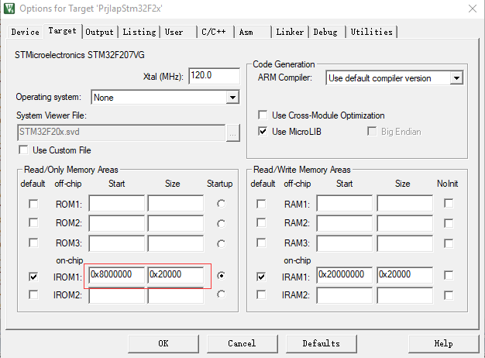
IAP Keil Project Configuration
IROM1: Start set to 0x800 0000, Size set to 0x20000 (128 KBytes)

Slide 17
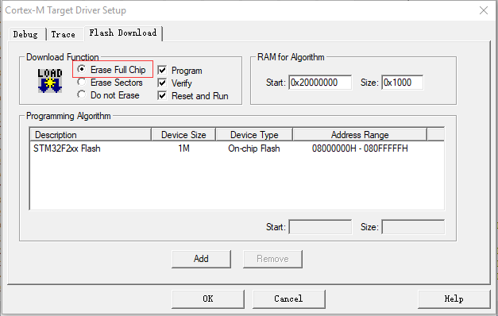
IAP Keil Project Configuration
When Burn IAP Program for the first time, make sure select “Erase Full Chip”

Slide 18

APP Keil Project Configuration
IROM1: Start set to 0x806 0000, Size set to 0x40000 (256K Bytes)

Slide 19
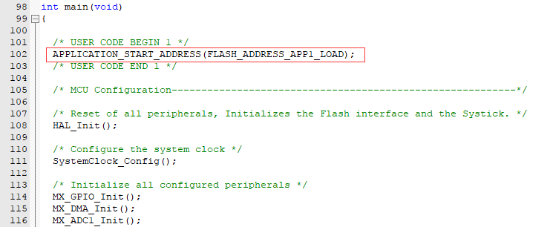
APP Keil Project Configuration
Define MACRO for Vector Table:
#define APPLICATION_START_ADDRESS(x) (SCB->VTOR=(x))
In first line of main() function of APP:
Feed watch dog less then every 16 seconds via in APP program (Not Support Yet):
HAL_IWDG_Refresh(&hiwdg);

Slide 20
Procedure to make IAP working
IAP and APP are configured as previous page
You get two .axf files, one for IAP (PrjIapStm32F2x.axf) and one for APP (PrjBfscFo@207VG.axf)
Convert APP .axf (take PrjBfscFo@207VG.axf as example) to bin file via:
C:\Keil_v5\ARM\ARMCC\bin\fromelf.exe --bin -o PrjBfscFo@207VG.bin PrjBfscFo@207VG.axf
Copy PrjBfscFo@207VG.bin to linux server, rename file as, make sure root have read access right:
/var/hcu/hcu_sw_active/IHU_HPT2049_PEM03_REL03_VER160_PACTH.BIN (ALL CAPITAL LETTER!!!)
Make sure PrjBfsc have been launched in linux, and CAN driver have been launched before that.
Burn IAP .axf via Jlink into stm32, full chip will be erased, (skip this if is not first time and IAP already there)
power up stm32 board, and download will be started automatically. (around 5 minutes needed for 11 stm32 boards)
NOTE1: Green light will be blinking if IAP is running
NOTE 2: Yellow light will be blinking if IAP is downloading new APP SW, need to wait for it, and do not power down !!!
NOTE 3: make sure 1) File name is all capital letter, and 2) version is increased, and decreased SW version will not be downloaded, or download will be not started, and stm32 will wait for 40 seconds to jump to APP !!!
NOTE4: do not delete IHU_HPT2049_PEM03_REL03_VER160_PACTH.BIN after update, or every time power up, stm32 will wait for 40s to jump to the app just updated.

Slide 21
SW Upgrade from Remote Server (For all End User SW packege)
Oct 2017, Bofeng & Xiaohui
V2

Slide 22


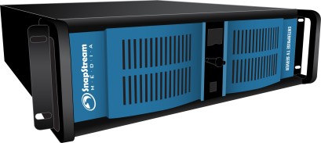

SW Upgrade from Remote Server
Full Software includes four parts:
IHU (下位机)
HCU (上位机)
hcudb.sql (增量数据库表单)
localui (界面)
NOTE1: 目前支持特定的一个产品类型有统一软件版本版本 （不支持一个产品的不同的客户有不同的版本）
NOTE2: 服务器端的上载操作目前由波峰公司完成
SW Update includes three major steps:
Step 1: Upload SW Download to Server
Step 2: SW Download from Server to HCU in the background
Step 3: Reboot/Power Down/Up to Apply the new SW
HCU / hcudb.sql / localui
Server
存储最新的软件版本
IHU * 12 or 16

Slide 23
SW Upgrade from Remote Server
WMC (Weight Motor Controller)
AWS (Automatic Weight System)
Remote Sever
IAP/IHU RUNNING
HCU RUNNING
STEP 1: NEW
IHU/HCU/hcudb.slq/bfscui
Uploaded to Server
Normal Operation
STEP 1: DOWNLOAD
NEW SW Download from Server to HCU
DIRECTION:
Server -> HCU
TIME:
SW_INVENTORY_REPORT
DOWNLOAD WILL HAPPEN in BACKGROUND
SW_INVENTORY_CONFIRM
( swVersionAvaillable, PackageSize )
FTP Download
不重启最长时间每一个小时查看并下载，重启之后会快速到服务器查看新软件并立即下载
NEW SW Downloaded
Inform User via GUI to restart/apply
STEP 2: APPLY
NEW SW Applied to
HCU and IHU
DIRECTION:
HCU -> HCU/IHU
TIME:
7~8 min for 12 IHU HW Version
STEP3: Power Up the machine
if user want to apply the new SW
New HCU/hcudb GUI will be applied
IHU SW will be APPLIED from to IHU if there is new IHU
(Procedure same as Part 2 Automatic SW update for stm32
Manual Operation
Normal Operation
Automatic Happen

Slide 24
SW Upgrade from Remote Server
下载方式：
系统使用过程中，HCU会以一个小时为周期检查服务器是否有新软件，有新软件，会自动下载。
每次系统重启，HCU会立刻（实际为1分钟内）到服务器检查是否有新的软件，如果有，HCU会自动开始下载。所以如果要快速下载，可以重启一次系统。
下载完成后，在界面的右下角会提示用户有新软件。此时需要再次重启系统，上下位机会同时更新新软件。
文件类型（特别注意：每次升级上载到升级服务器的文件类型一定是以下的几种）:
Ihu: .BIN (由.AXF文件通过工具转换生成)
Sql: .SQL (注意：这个是和上次版本的Delta，不是初始数据库，初始数据库要导入，不是升级)
hcu & localui: .HEX (.HEX 同时包括hcu和localui的程序，升级过程会自动解包处理)
依赖关系：
.sql一定要有hcu的更新
hcu不一定有.sql更新
hcu与localui没有依赖关系

Slide 25
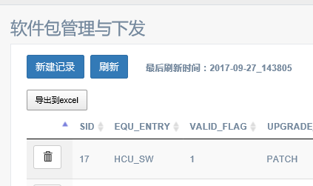
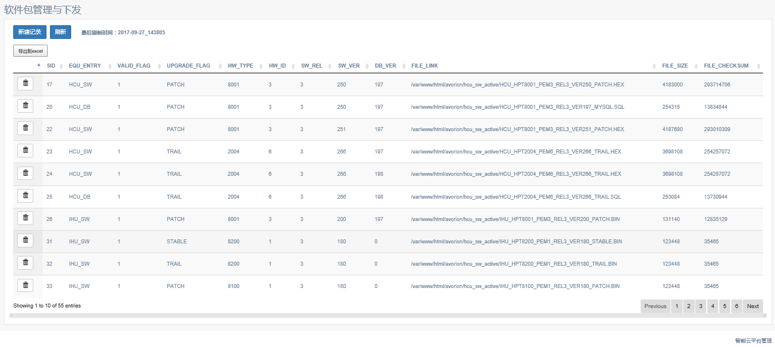
SW Upgrade from Remote Server – STEP0
Visit following address, with user/password admin/xiaohui123
http://www.hkrob.com/admintools/softload/login.html
Click “新建记录”, See next page

Slide 26
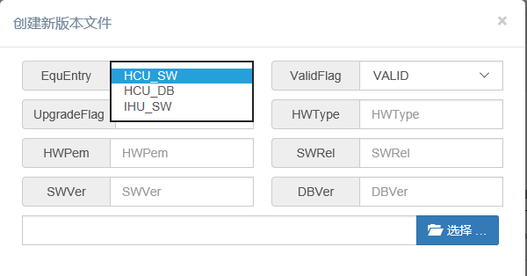
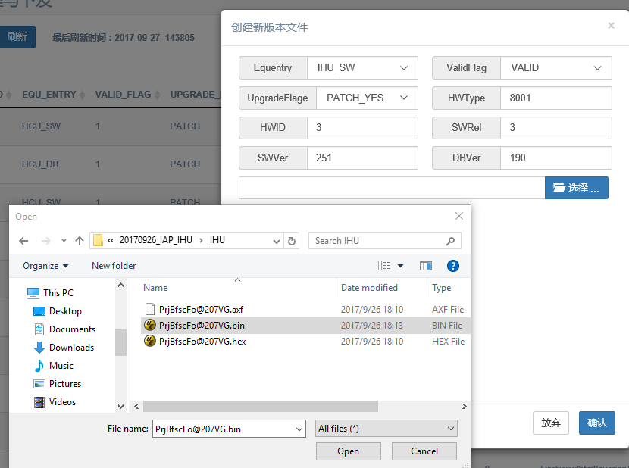
SW Upgrade from Remote Server – STEP1
Entity:
IHU_SW: ihu sw (.BIN)
HCU_DB : .sql (.SQL)
HCU_SW: hcu/PrjBfsc sw and localui (.HEX)
ValidFlag: Choose “VALID”
UpgradeFlag: Each machine HW belongs to one of the three types if “New SW Application”:
PATCH: In Factory HW
TRIAL: Apply in Trial HW
STABLE: Apply in Stable HW
HWType: 8001 for BFSC (组合称)
HWPemID: HW PEM Version
SWRel: SW Release ID
SWVer: SW Version ID
DBVer: hcudb.slq ID

Slide 27
How to make sure HCU and IHU can upgrade from Remote Server
File and directory list in HCU:
/var/hcu/hcu_sw_active/ -> SW downloaded will be save here
/var/hcu/hcu_new -> SW zip file contains hcu executable and also .sql incremental database
/var/hcu/hcu -> hcu executable file
/var/hcu/cfg/hcuboot.cfg -> this FILE will need to be modified only in FACTORY!!!!
/etc/init.d/hcu.sh -> shell script will be run every time reboot, to replace the old hcu SW with new
NOTE:
ONLY FOR BOFENG TO UNDERSTAND THE SW UPGRADE MACHINISM
Make sure all directly is executable/entered by everyone
DO NOT TOUCH THESE FILE WHEN DELIVERED TO CUSTOMER

Slide 28
AUTO STARTUP GUI – INITIAL COMMISION (初始安装)
前提条件(prerequisite):
1) Install ubuntu and all libraries, includes LAMP, CAN, MQTT, etc …
2) Impact Initial db, this is not via SW UPGRADE SERVER, by phpmyadmin (BLANK DB)
A: hcu auto start 1. copy hcu.sh to /etc/init.d/ 2. #cd /etc/init.d 3, #chmod 755 hcu.sh 2. #update-rc.d hcu.sh defaults 3. #mkdir /var/hcu 4. copy working PrjBfsc (or hcu) to /var/hcu <NOTE1>: Change name .HEX to .ZIP, unzip .ZIP file, and extract the “hcu” 5. cd /var/hcu/ 6. #mv PrjBfsc hcu <NOTE1>: Change name .HEX to .ZIP, unzip .ZIP file, and extract the “hcu” 7. make sure /var/hcu/cfg/hcuboot.cfg exist <NOTE2>: Edit “hcuboot.cfg“ according next page restart computer, use following command to check whether hcu has been started automatically: #top there will be hcu process running or #ps -ef | grep hcu B. After login 1. launch dish in GUI 2. search for "start" 3. run "startup applications" 4. add Chromium, with following command /usr/bin/chromium-browser --password-store=basic --app=http://localhost/localui/login.html --start-fullscreen restart computer to check whether GUI has been pop up automatically

Slide 29
AUTO STARTUP GUI – INITIAL COMMISION (初始安装) /var/hcu/hcuboot.cfg
<xml>
<equLable>HCU_G8001BFSC_SH001</equLable>
<hw_mac>11:22:33:44:55</hw_mac>
<zhbMnLable>ABCDEFG1234567</zhbMnLable>
<hwType>8001</hwType>
<hwPemId>3</hwPemId>
<swRelId>3</swRelId>
<swVerId>148</swVerId>
<dbVerId>111</dbVerId>
<swUpgradeFlag>2</swUpgradeFlag>
<swUpgPollId>11</swUpgPollId>
<bootIndex>1</bootIndex>
<bootAreaMax>3</bootAreaMax>
<facLoadAddr></facLoadAddr>
<facLoadSwRel></facLoadSwRel>
<facLoadSwVer></facLoadSwVer>
<facLoadCheckSum></facLoadCheckSum>
<facLoadValid></facLoadValid>
<spare2></spare2>
<bootLoad1Addr></bootLoad1Addr>
<bootLoad1RelId></bootLoad1RelId>
<bootLoad1VerId></bootLoad1VerId>
<bootLoad1CheckSum></bootLoad1CheckSum>
<bootLoad1Valid></bootLoad1Valid>
<spare3></spare3>
<bootLoad2Addr></bootLoad2Addr>
<bootLoad2RelId></bootLoad2RelId>
<bootLoad2VerId></bootLoad2VerId>
<bootLoad2CheckSum></bootLoad2CheckSum>
<bootLoad2Valid></bootLoad2Valid>
<spare4></spare4>
<bootLoad3Addr></bootLoad3Addr>
<bootLoad3RelId></bootLoad3RelId>
<bootLoad3VerId></bootLoad3VerId>
<bootLoad3CheckSum></bootLoad3CheckSum>
<bootLoad3Valid></bootLoad3Valid>
<spare5></spare5>
<cipherKey></cipherKey>
<rsv></rsv>
<nodeHwType>8001</nodeHwType>
<nodeHwPemId>3</nodeHwPemId>
</xml>
<equLable>HCU_G8001BFSC_SH001</equLable>:
“SH001” must be the different for each of the HW manufactured, can not modified after delivered to the customers.
<swUpgradeFlag> in HCU definition:
#define HUITP_IEID_UNI_FW_UPGRADE_YES_STABLE 2
#define HUITP_IEID_UNI_FW_UPGRADE_YES_TRIAL 3
#define HUITP_IEID_UNI_FW_UPGRADE_YES_PATCH 4
<swUpgradeFlag> in IHU definition:
- Will always equals to 2 (STABLE) in ihu (via FULL CHIP BURN)
Can be modified via FMPT in future.
<swUpgradeFlag> must to the same between HCU and IHU (default is STABLE), or System can be not started!!
<nodeHwType>8001</nodeHwType>
Must be 8001 for BFSC Combination Weight Machine

Slide 30
UPDATE 2017/10/17
Change Steps after changed from bfscui to localui:
rename "/var/www/html/bfscui" to "/var/www/html/localui“
change chromium startup from "http://localhost/bfscui" to http://localhost/localui/login.html
replace /etc/init.d/hcu.sh with the hcu_advantech.sh, and make sure hcu.sh is executable (755).
use the this .pdf to update HCU/IHU

Slide 31
UPDATE 2018/03/23
手动换下位机的过程

Slide 32
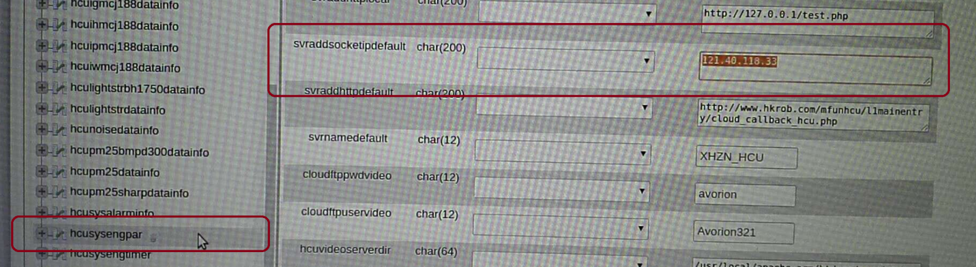
UPDATE 2018/04/08
每个生产出来的机器，可以有一个属性，标识要升级的时候自动升级的软件的类型：PATCH或者STABLE版本。
出厂标识为PATCH的机器，只会选择PATCH的软件版本自动升级，出厂标识为STABLE的机器，只会自动下载升级标识为STABLE的软件。
一般的使用场景是工厂（或可以接受自由升级测试版本的的友好客户）用PATCH，做新功能的预测试。最终的客户，用STABLE的版本，使用通过PATCH测试过的版本
类型标识的方法在下面，分别改HCU配置文件和重烧IAP类型决定（IAP分PATCH和STABLE版本）。
http://47.100.191.83/admintools/softload/login.html
用户名密码和原来一样， admin/admin123
需要把HCU数据库里的IP改一下， ip改成波峰云地址47.100.191.83
Table: hcusysengpar
这个表里有多条记录，对应不同项目，组合秤就选 HCU_PRJ_BFSC_CBU
工厂的机器要做成PATCH版本进行测试（注意26页的PATCH/STABLE的区别）
HCU: /var/hcu/hcuboot.cfg => <swUpgradeFlag> = 4
IHU/IAP: BURN IAP PATCH version (see DeliveryNote 20171020)（里面有IAP的两个版本）
客户的机器做成STABLE版本，在工厂测试结束后再次上载，会自动升级（注意26页的PATCH/STABLE的区别）

Slide 33
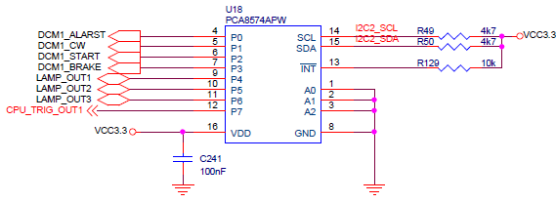
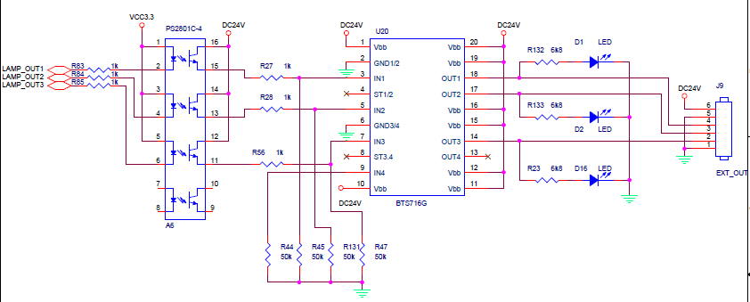
2018/04/27,组合称针对HW-V2（如何扩展4个摇臂）的讨论
分选版（第17号板）讨论的结论是将组合称的板子的CPU_TRIG_OUT1改为LAMP_OUT4，拉到板外（J9第5脚）
板号（通过DIP开关）的定义：
DIP = 0（大马达）
DIP = 1, …, 16（1到16号称台）
DIP = 17（分选板）
四个摇臂分别连接：
LAMP_OUT1（J9第4脚）
LAMP_OUT2 （J9第3脚）
LAMP_OUT3 （J9第2脚）
LAMP_OUT4 （J9第5脚）

Slide 34
Factory Mass Production Tools
Purpose of FMPT:
To Read/Check/Burn the FLASH before sending to the customer for:
mass production
repairing purpose
User Interface
GUI
Command Line (easy for scripts)
OS
Windows 7/10
Interface support:
CAN with 500kbps
UART3 with 115200bps
Micro Function Support
Read FLASH with given address and length
Lock/Unlock FLASH
Erase FLASH with given sector(s)
Write FLASH with given address and length
Macro Function Support(in GUI)
Read Boot Config Table
Edit Boot Config Table

Slide 35
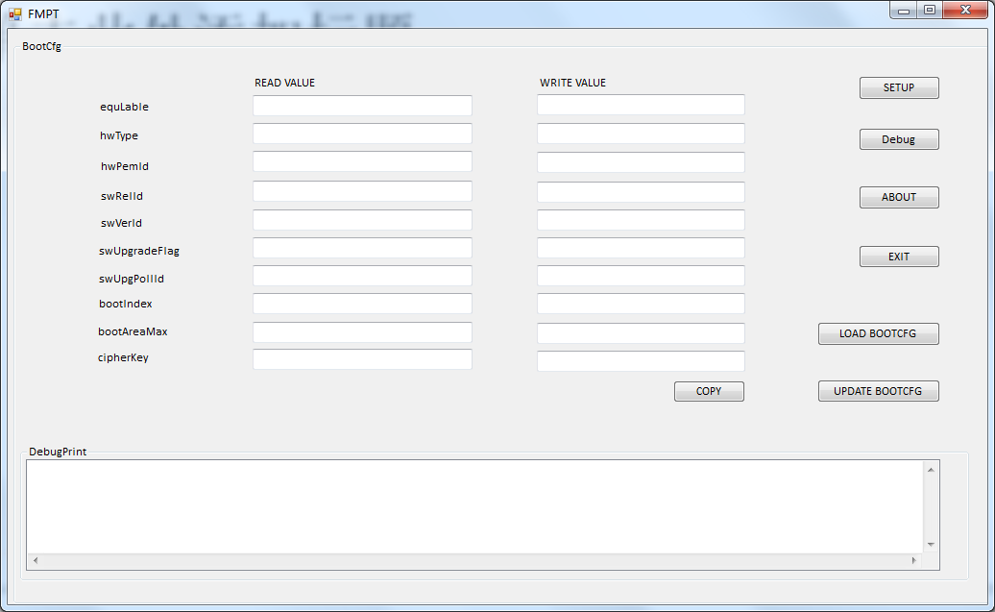
Main interface

Slide 36
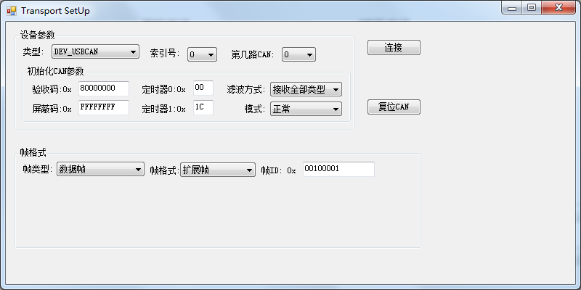
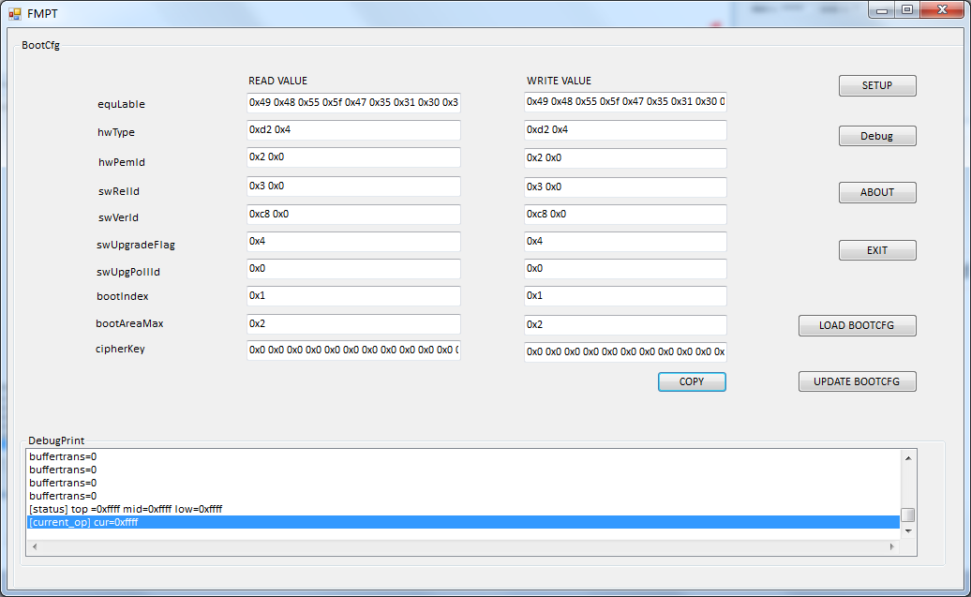
How to use this FMPT Tool
Step 2:
click connect button
Step 1:click this and
pop out this UI
this debug button used to copy
the debug information
Step 3:click this will show the read value
in the green section
Step 4:click this button to copy
the value from read value
then you can change the value
you need
Step 5:click this to upgrade the write value

Slide 37
Caution!
Caution ONE:
Only in the red zone
0xd2 0x4 means 0x04d2
0x2 0x0 means 0x2
0x2 0x0 means 0x3
0xc8 0x0 means 0xc8
2 bytes 高位在后，低位在前
Caution TWO:
Don't delete the space after all the value

Slide 38
Thanks
Q&A

